Slide 1
Data Filling
Techniques and Methods
THE METHOD
GAP
FILLING
Raleigh 2018

Slide 2


THE METHOD
BEN’S
GAP
FILLING

Slide 3
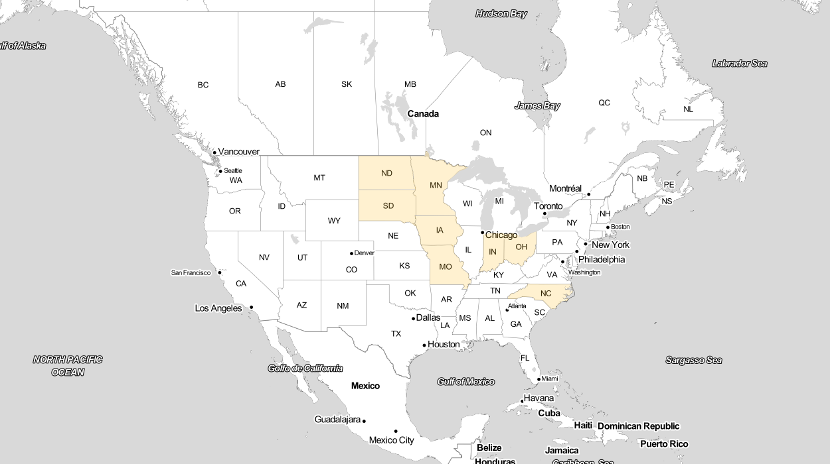
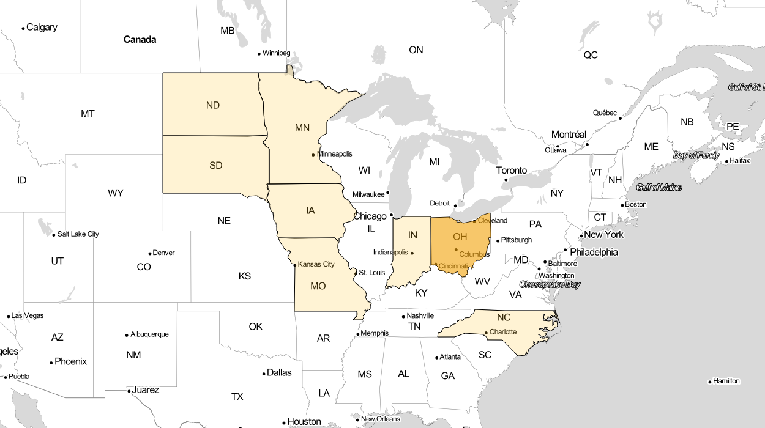
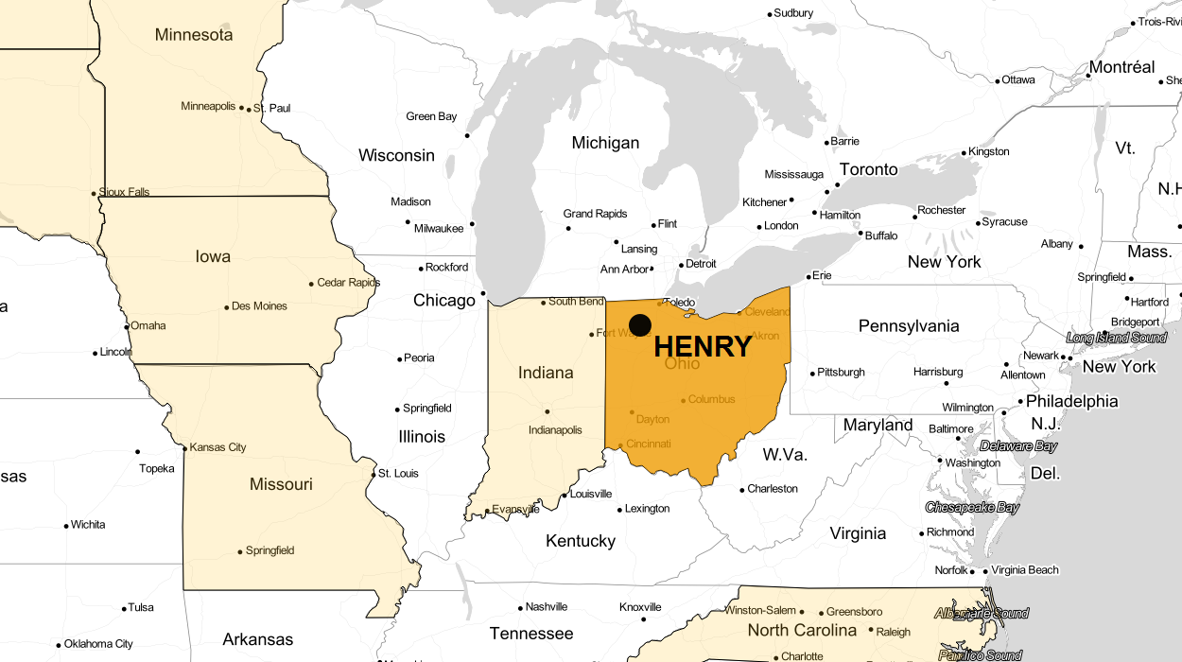

Slide 4
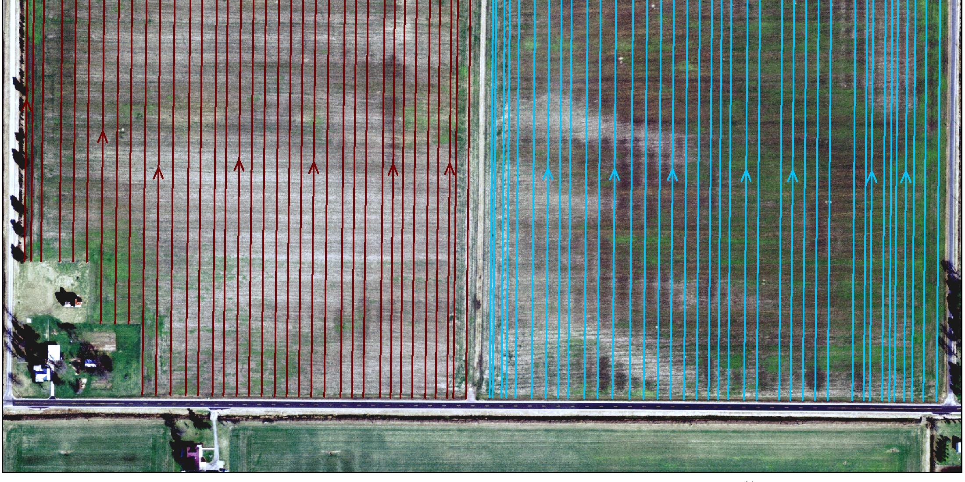
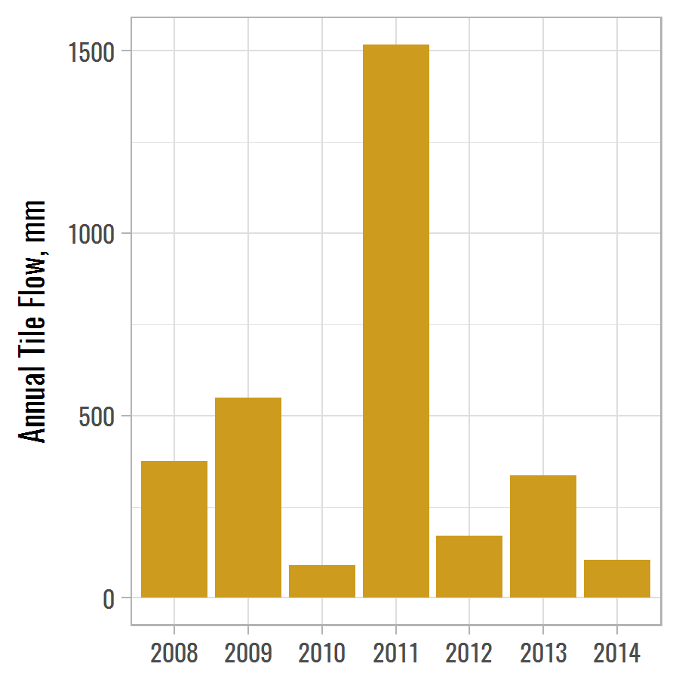

This is HENRY

Slide 5
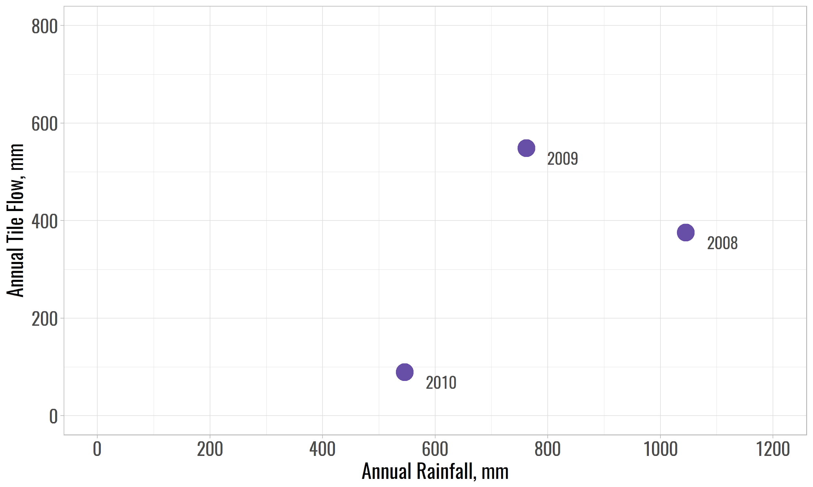
More Rain More Tile Flow

Slide 6
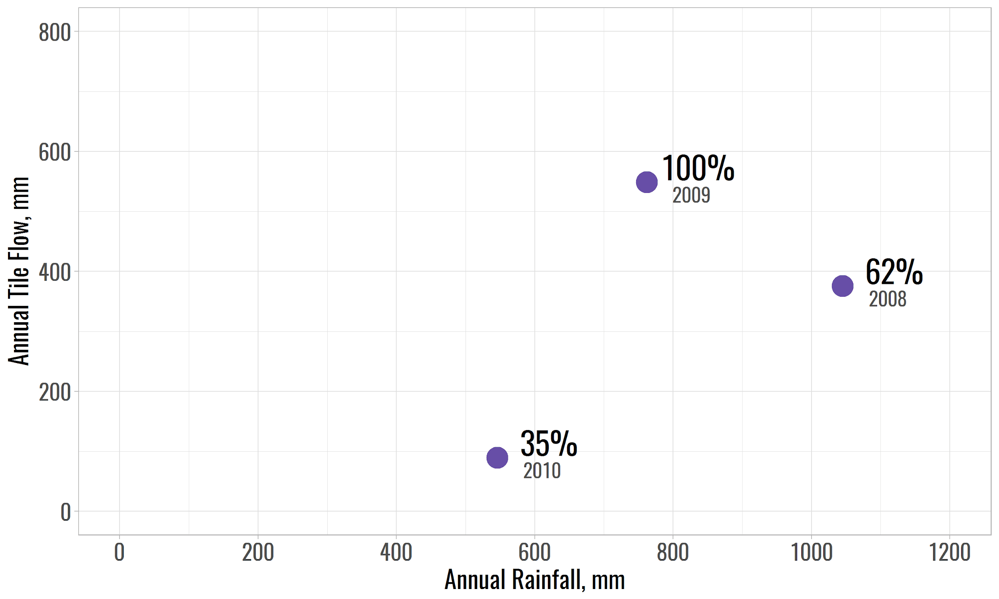
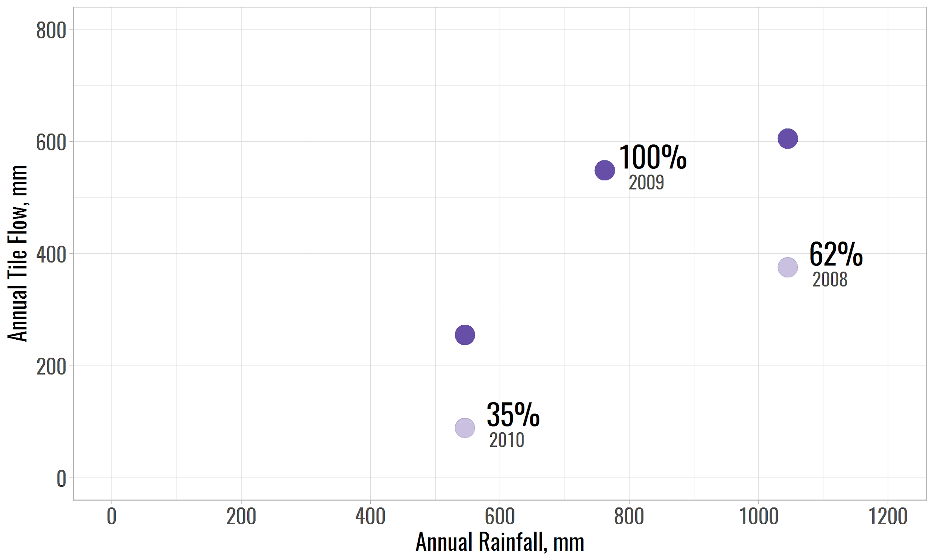
Less Data Less Tile Flow
Notes:
There is a catch - Mean imputation implies that missing data is randomly distributed

Slide 7
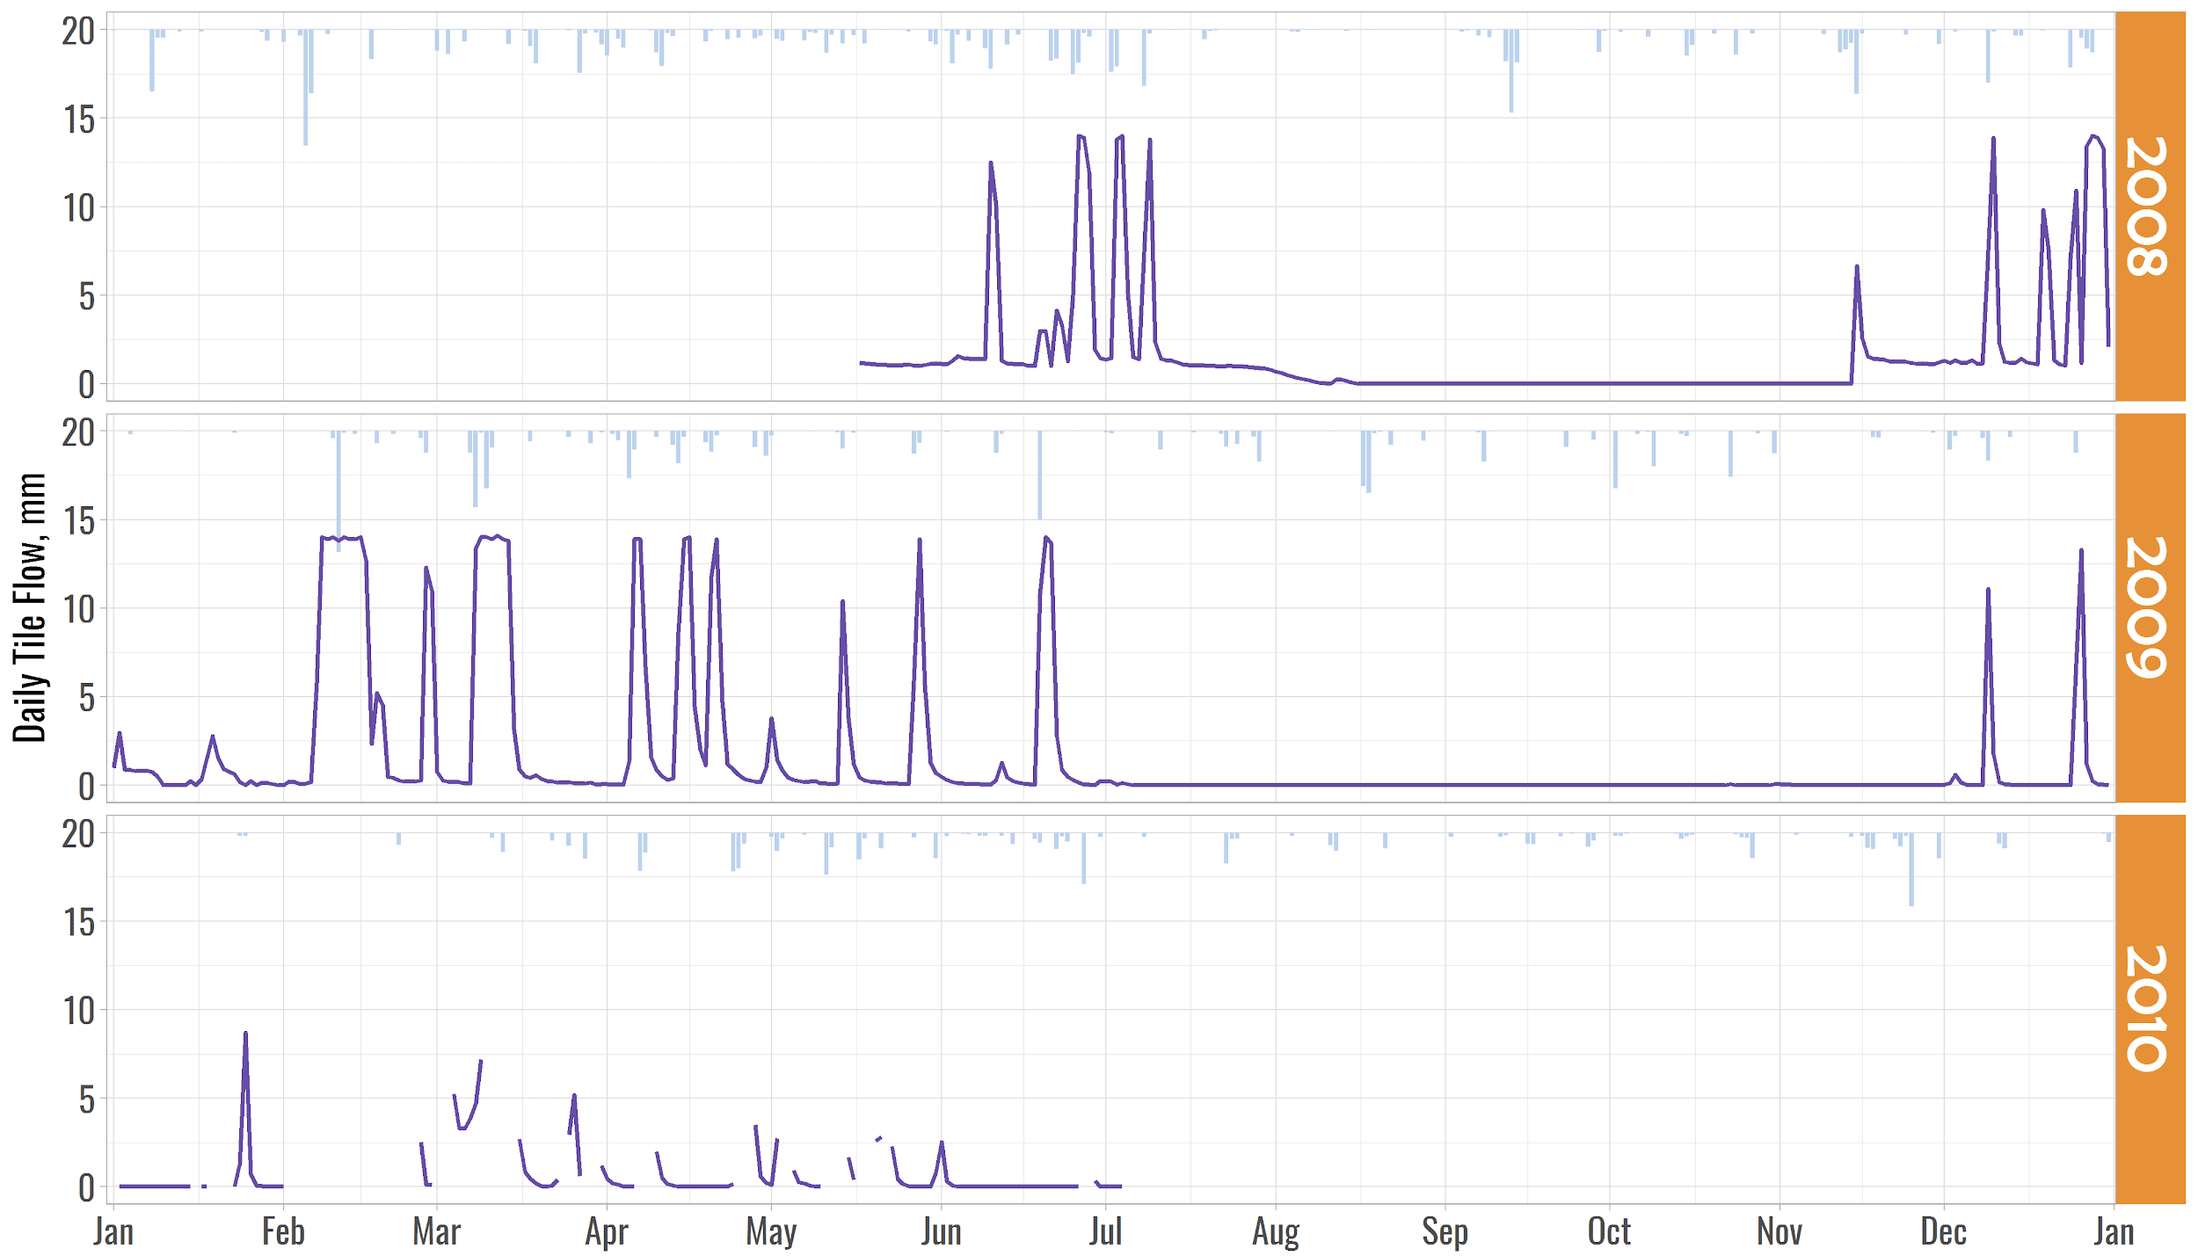
THE METHOD
Notes:
Distribution of missing tile flow data is ANYTHING, BUT RANDOM

Slide 8
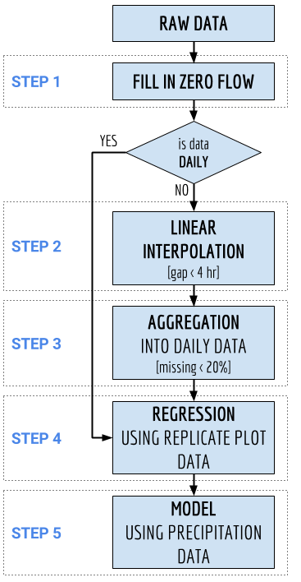
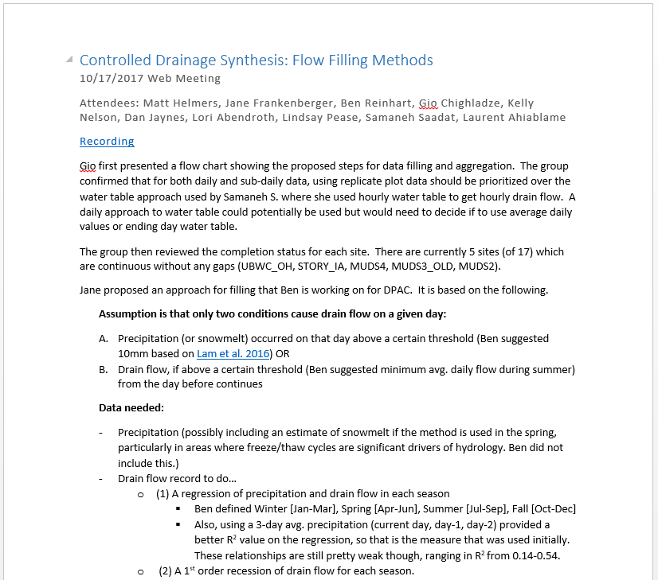
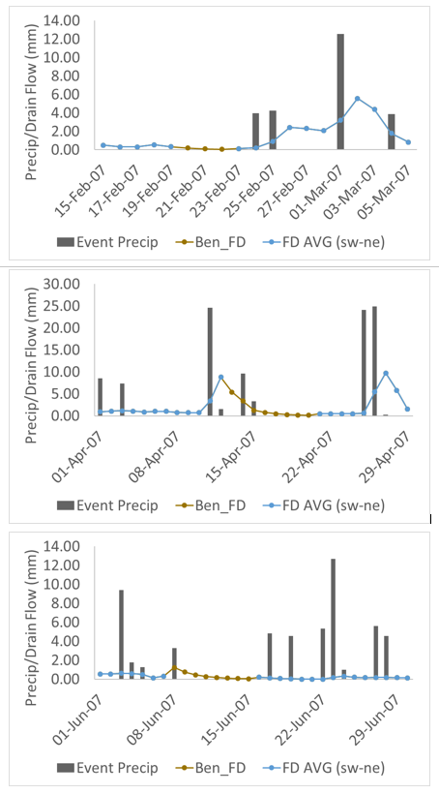
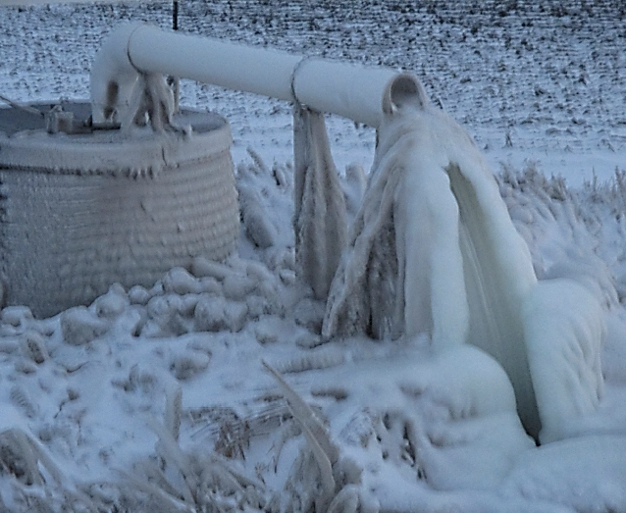

THE METHOD
in the Northern States far, far away...
Notes:
Northern States - and I do NOT mean NORTH CAROLINA
STEP 4 > REGRESSION - assuming that Replicated research plots are not too big, there are no a big difference in soil type and topography

Slide 9
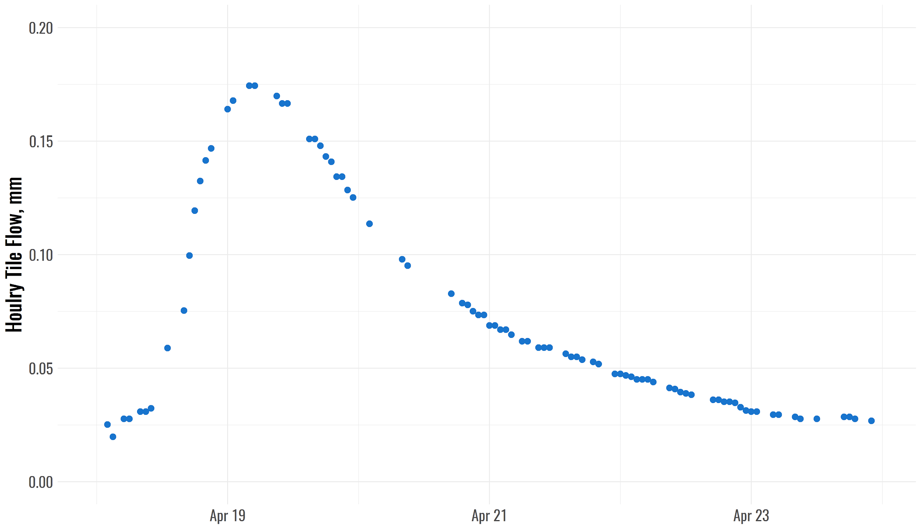
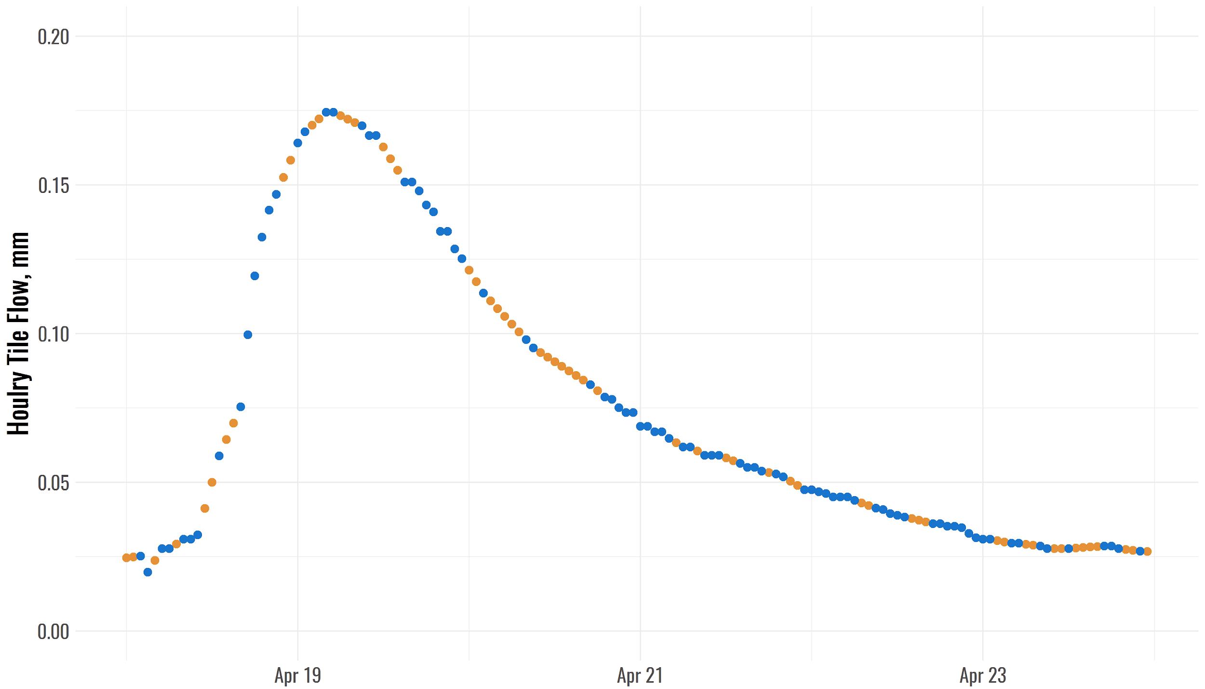
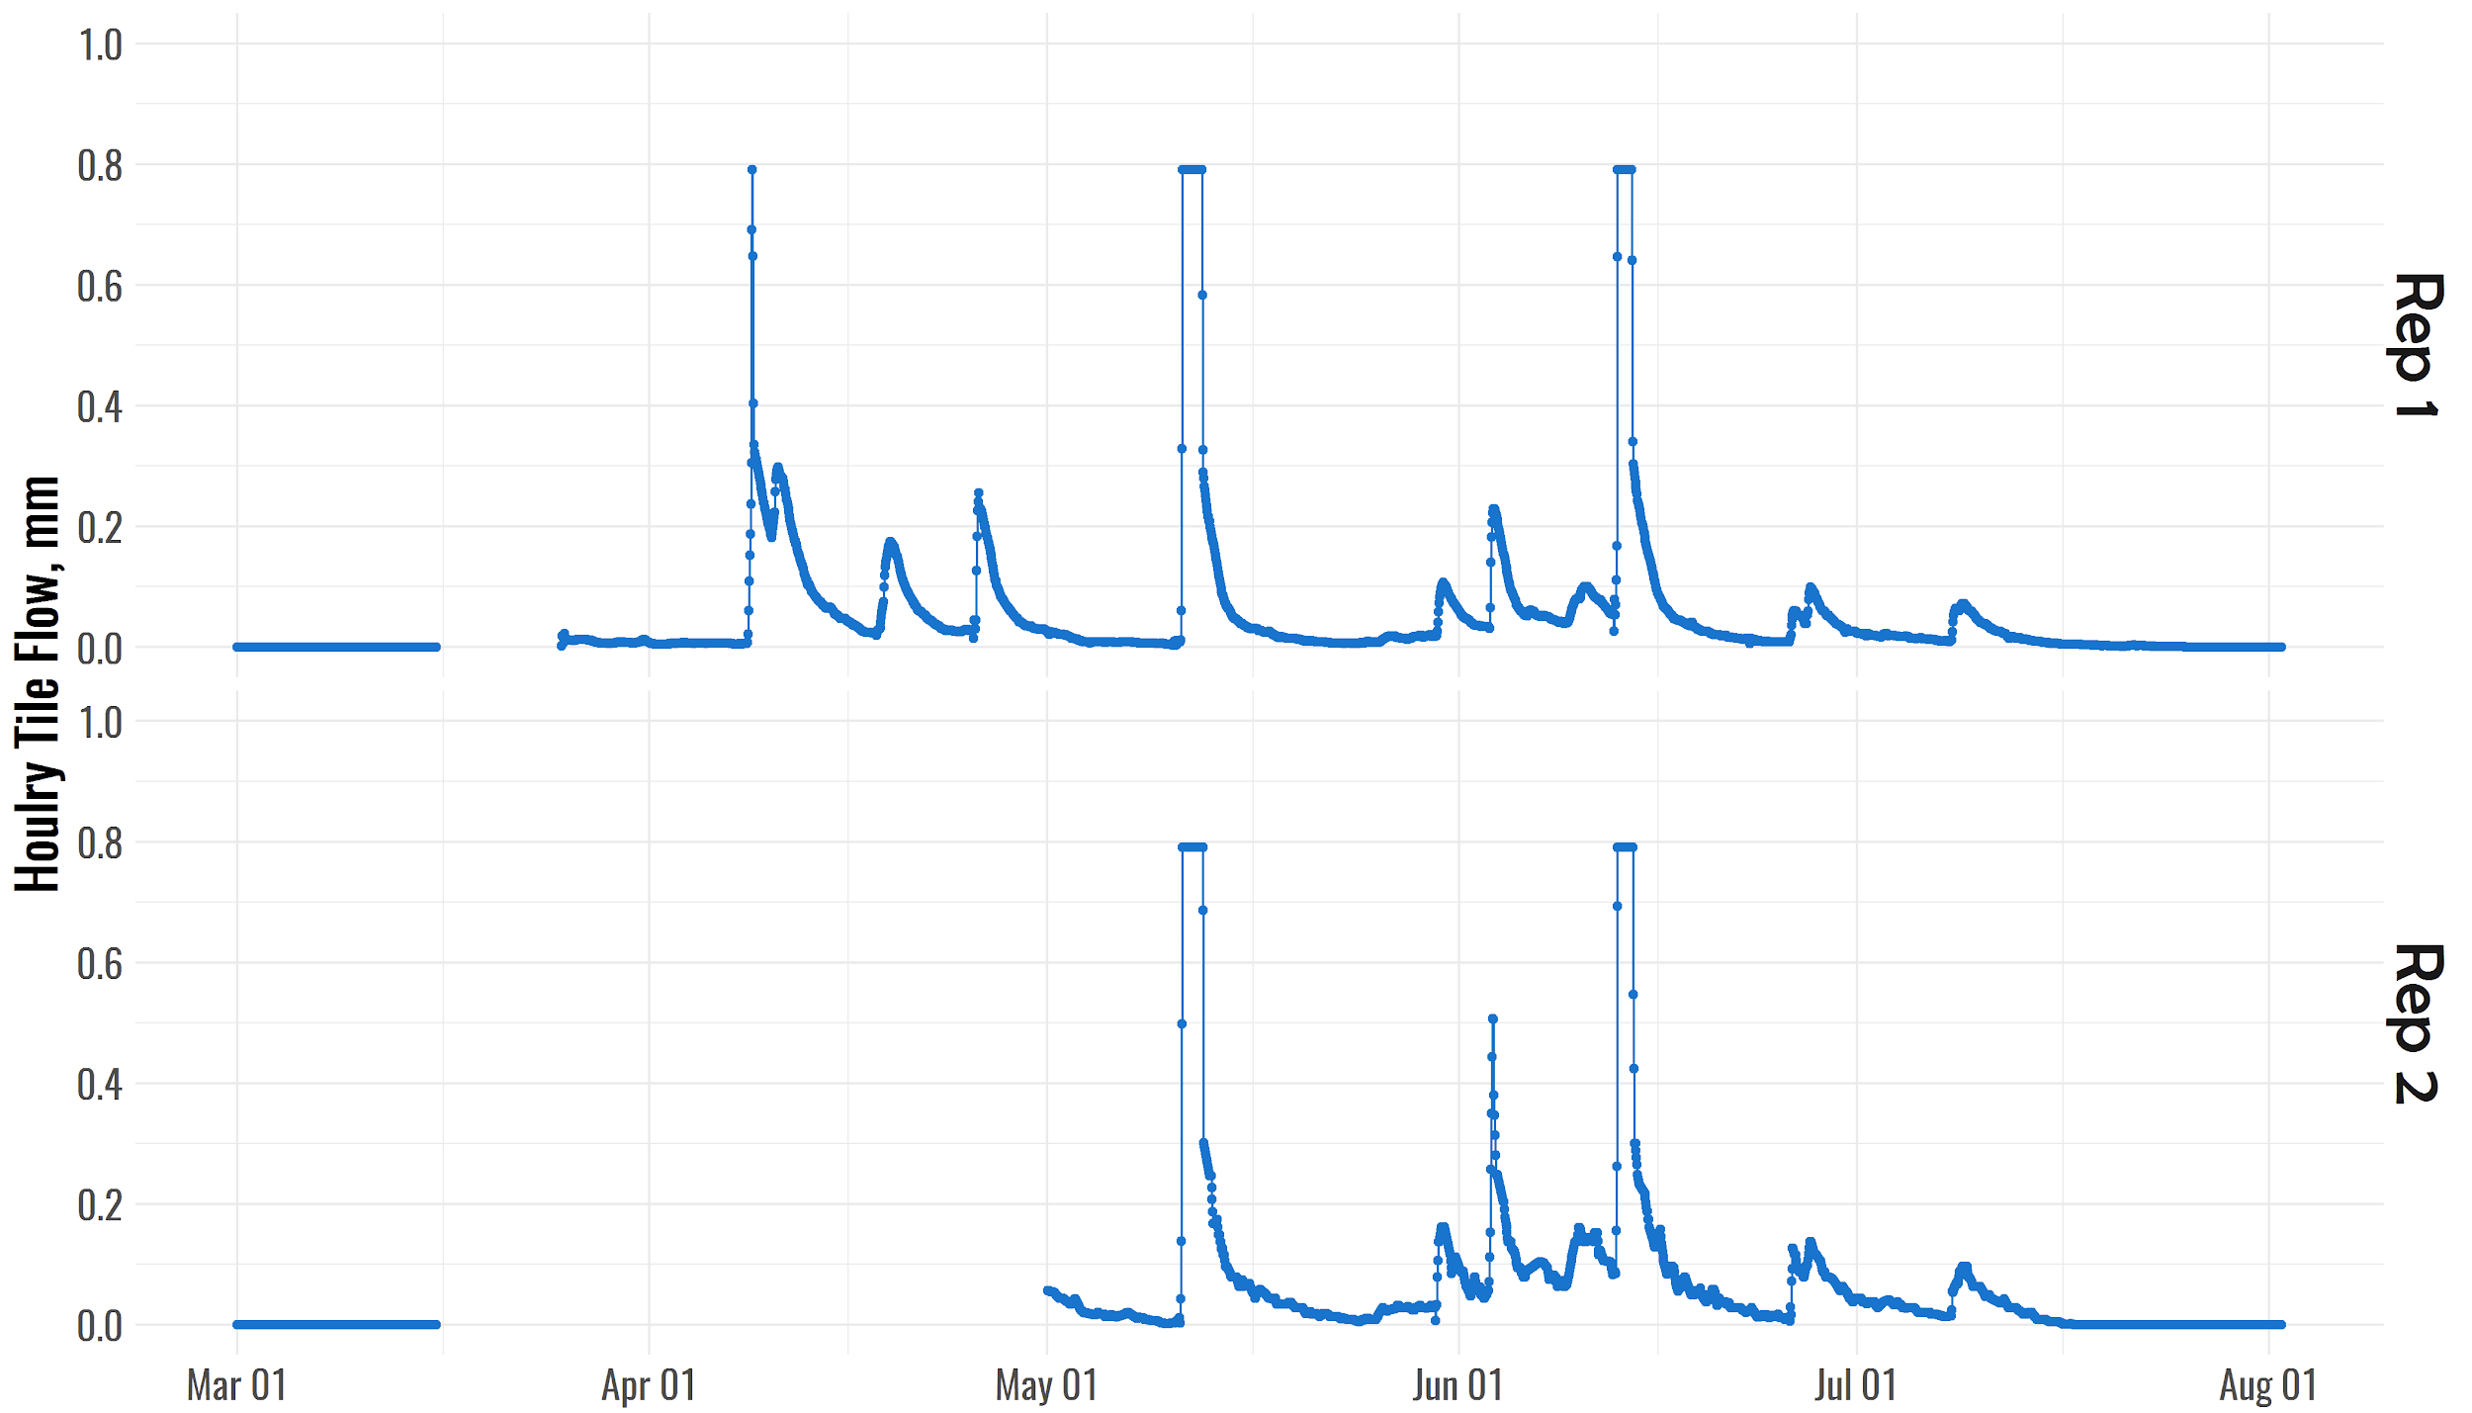
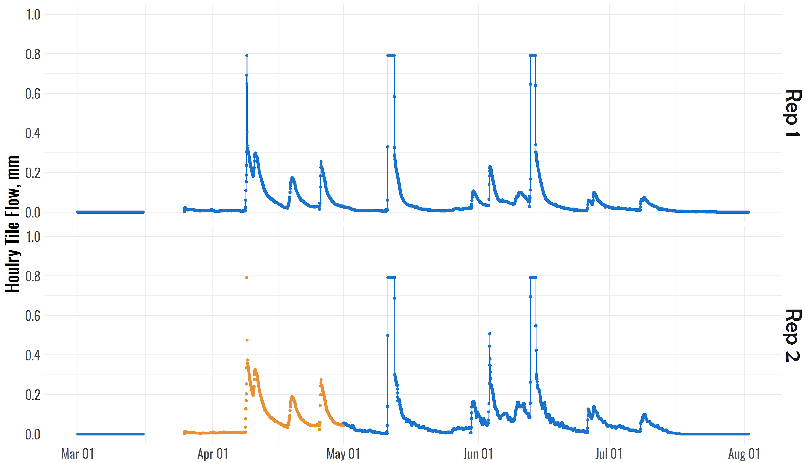
THE METHOD

Slide 10
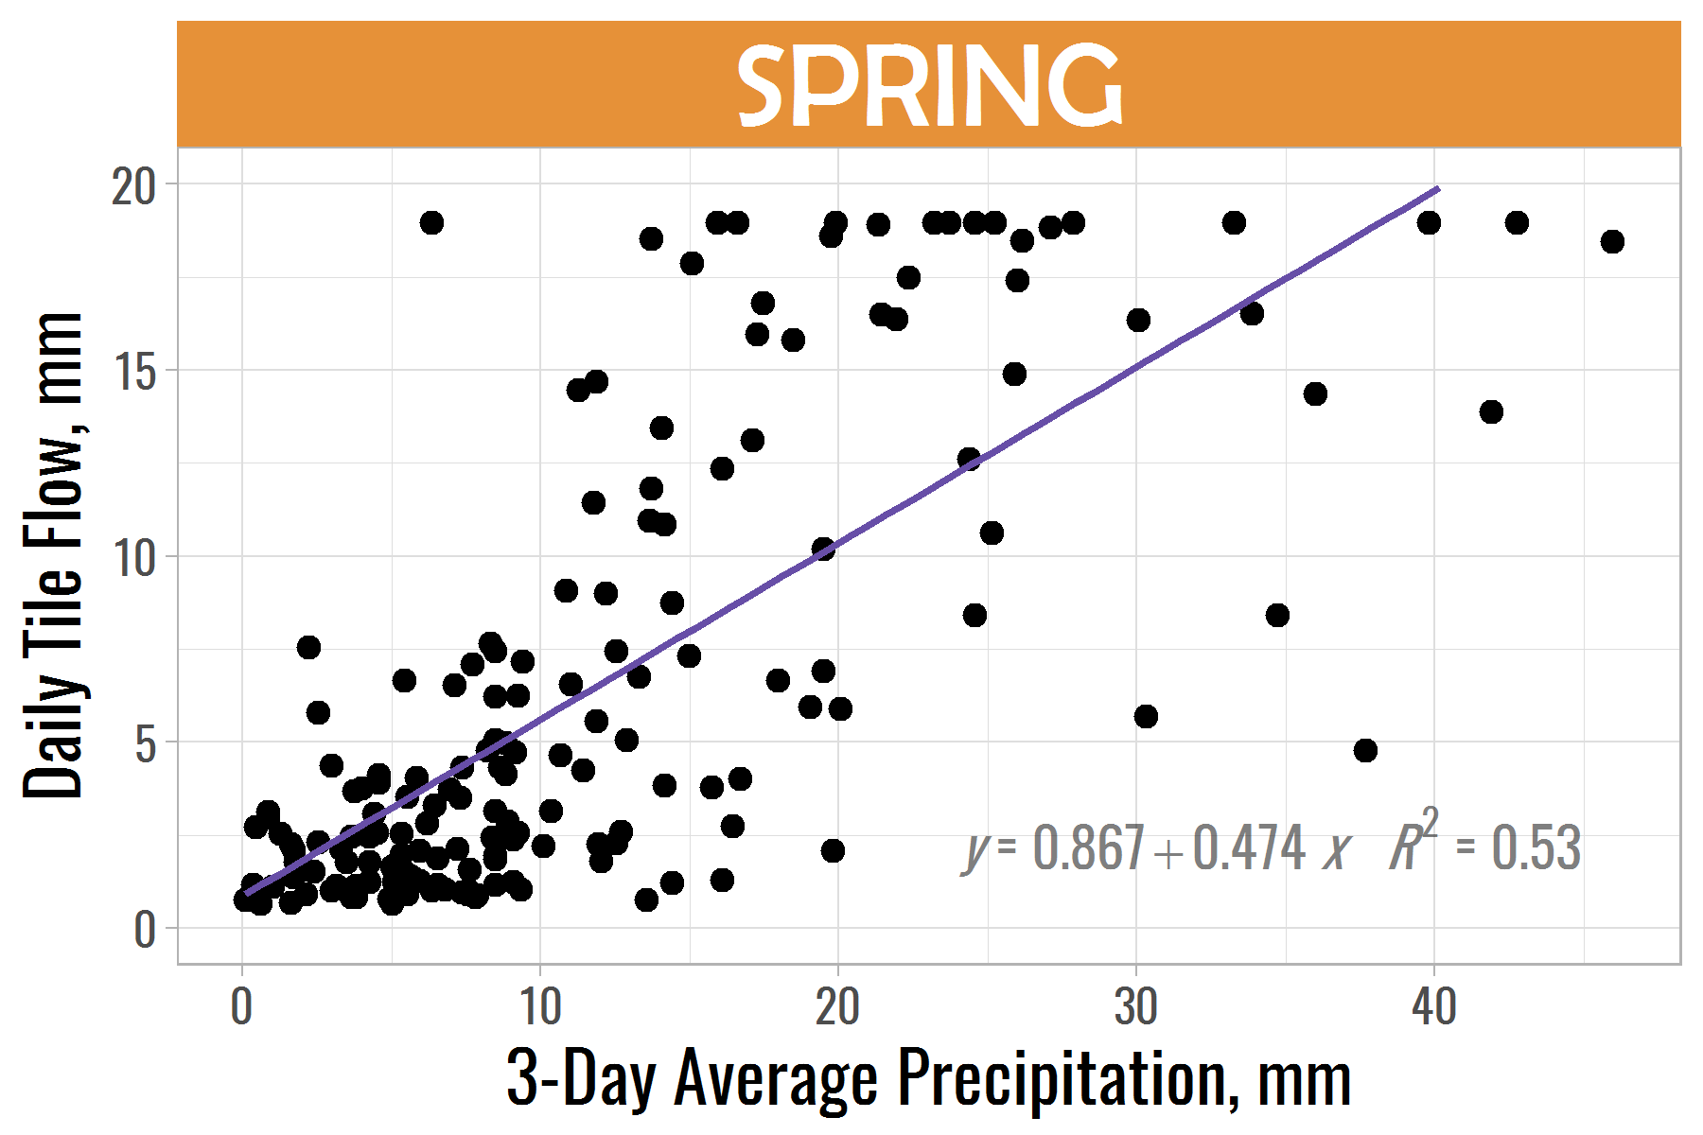
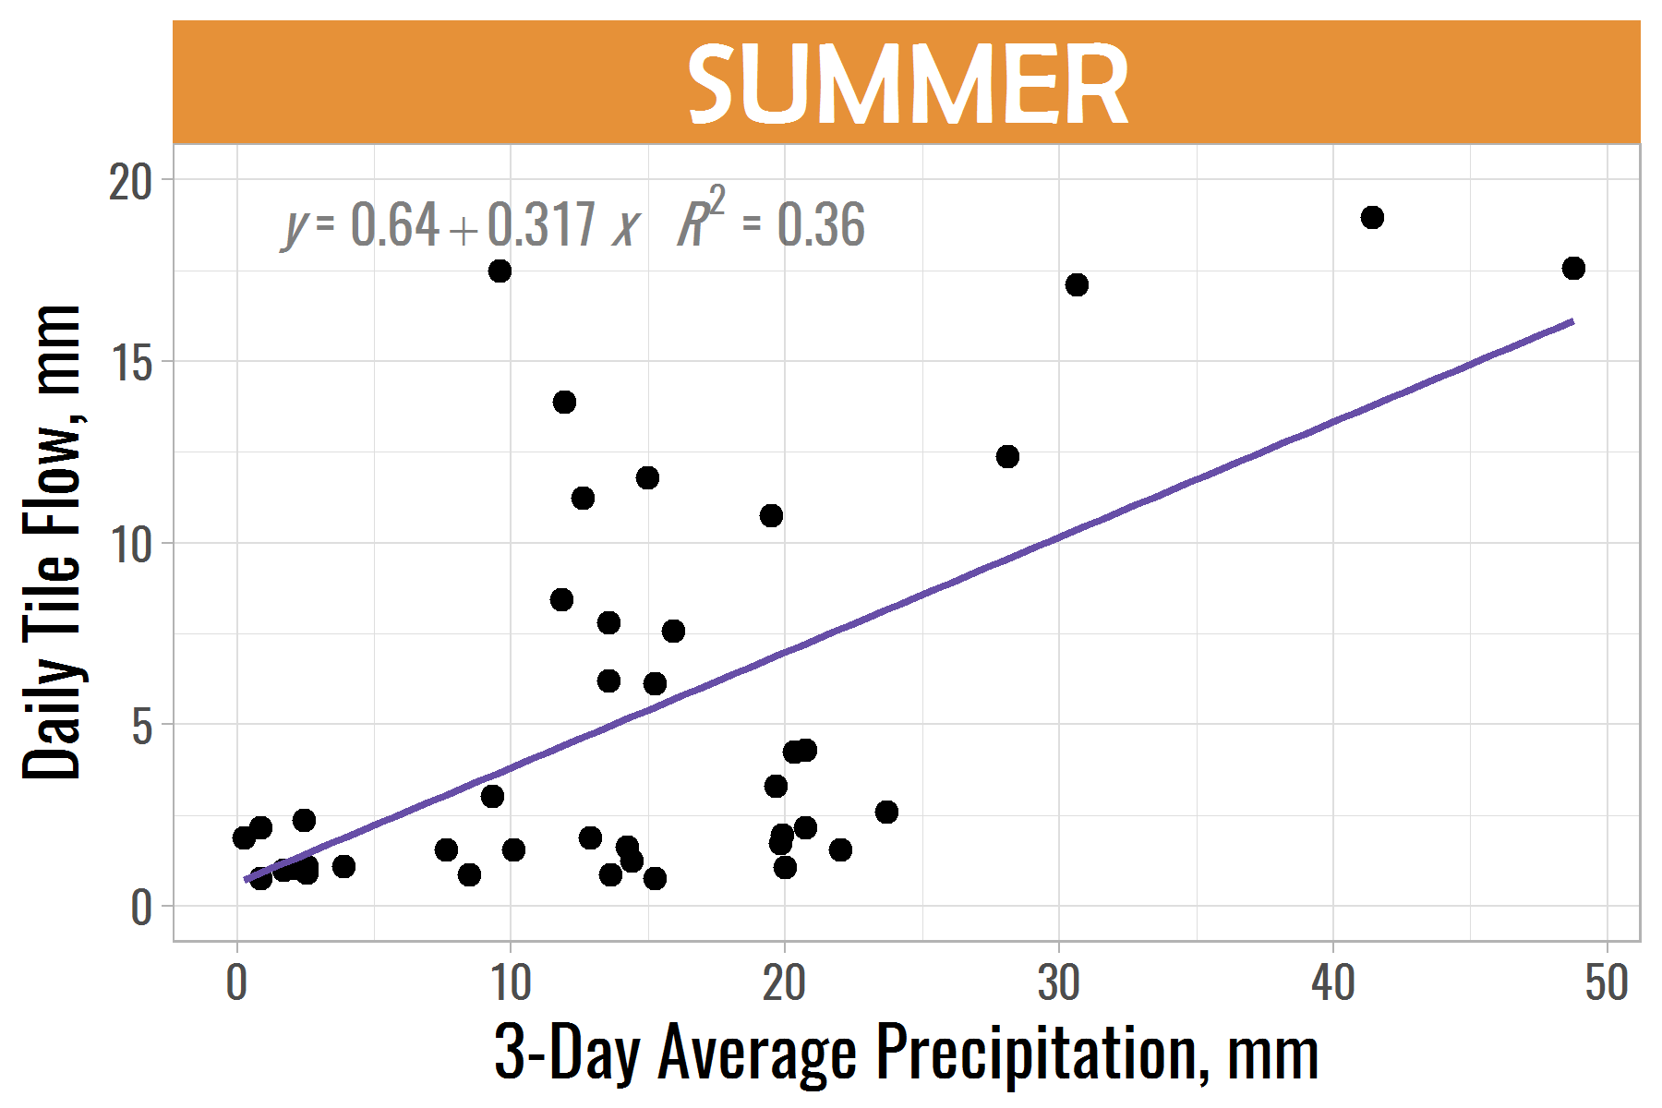
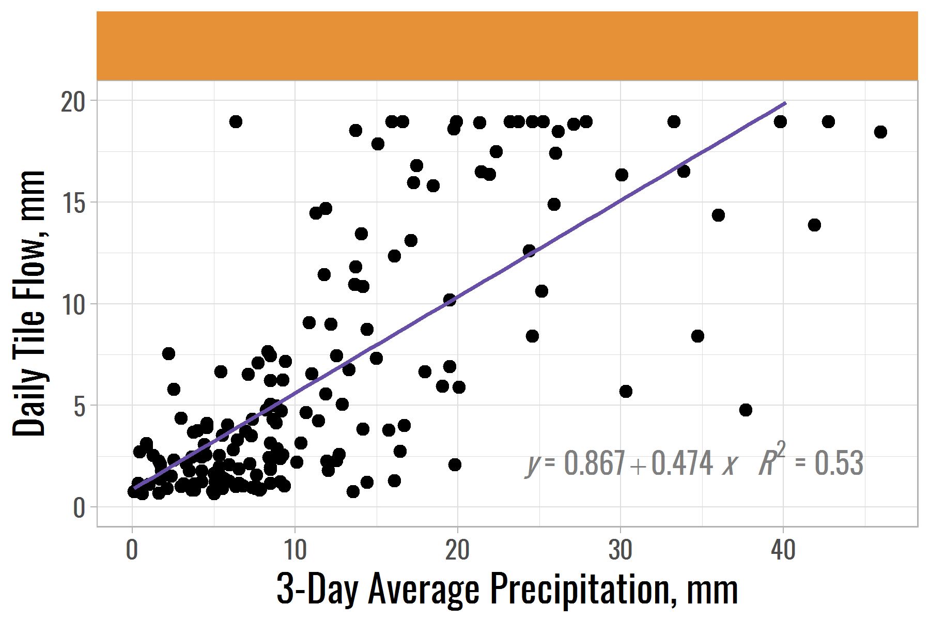
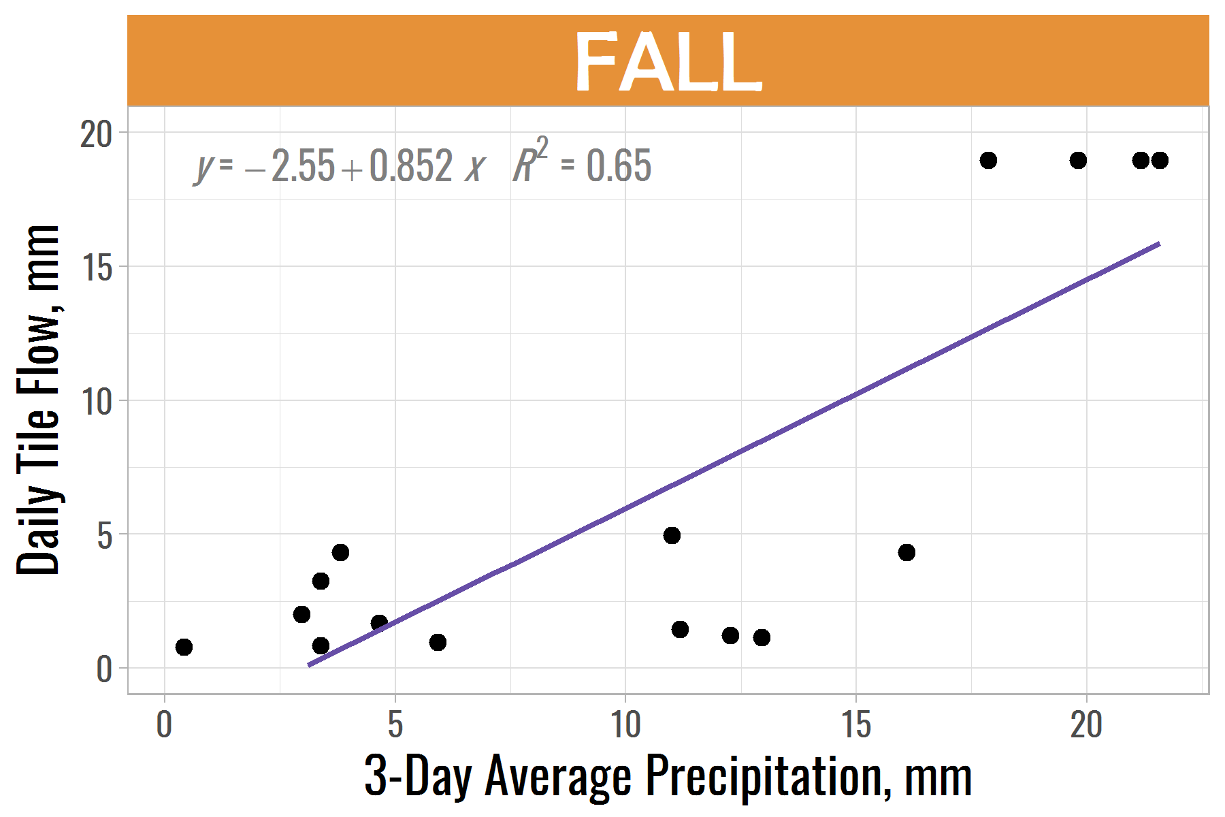
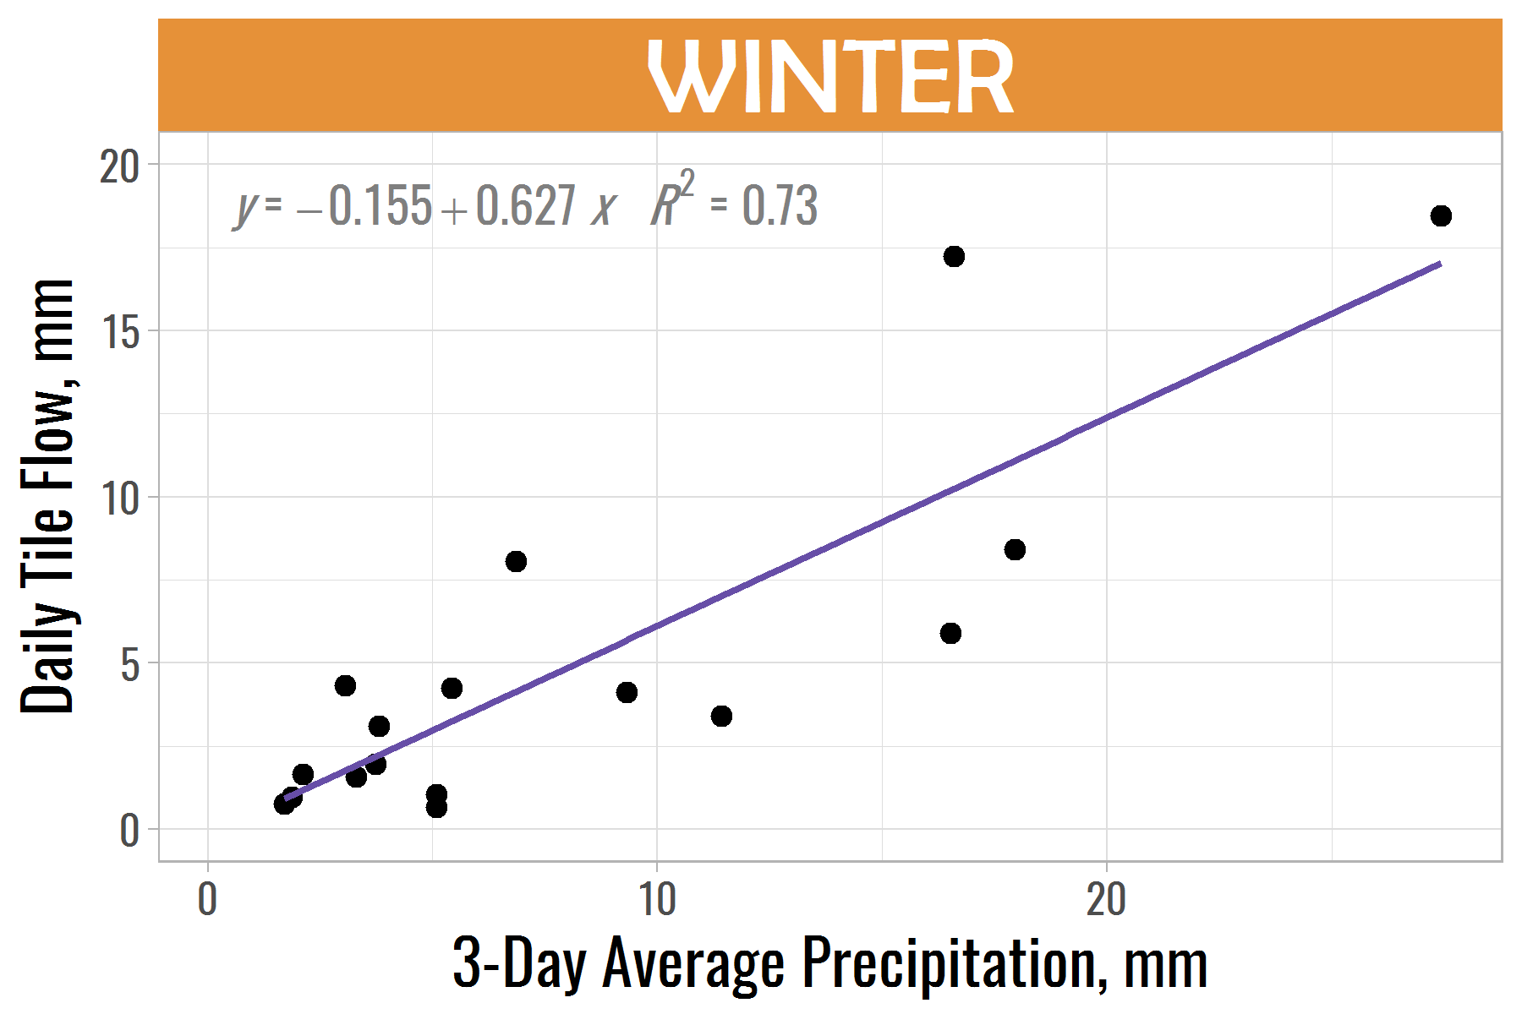
THE METHOD
Part 1 Predict Pick Flow

Slide 11
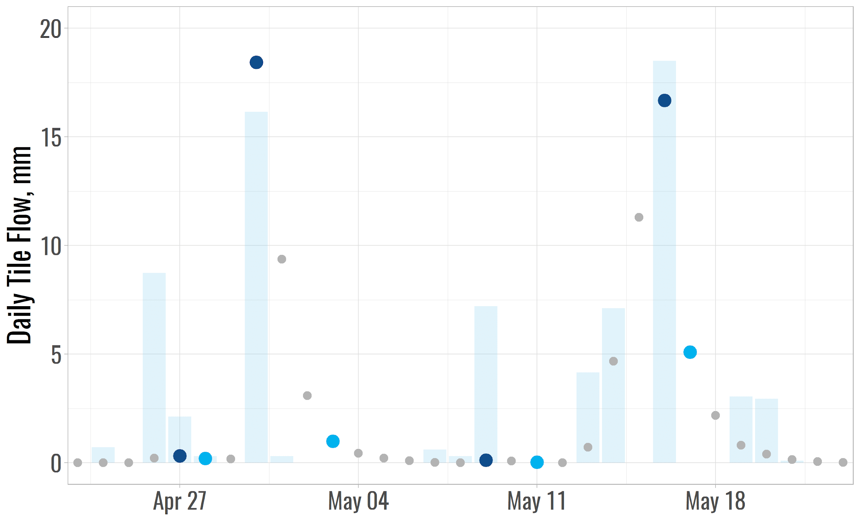
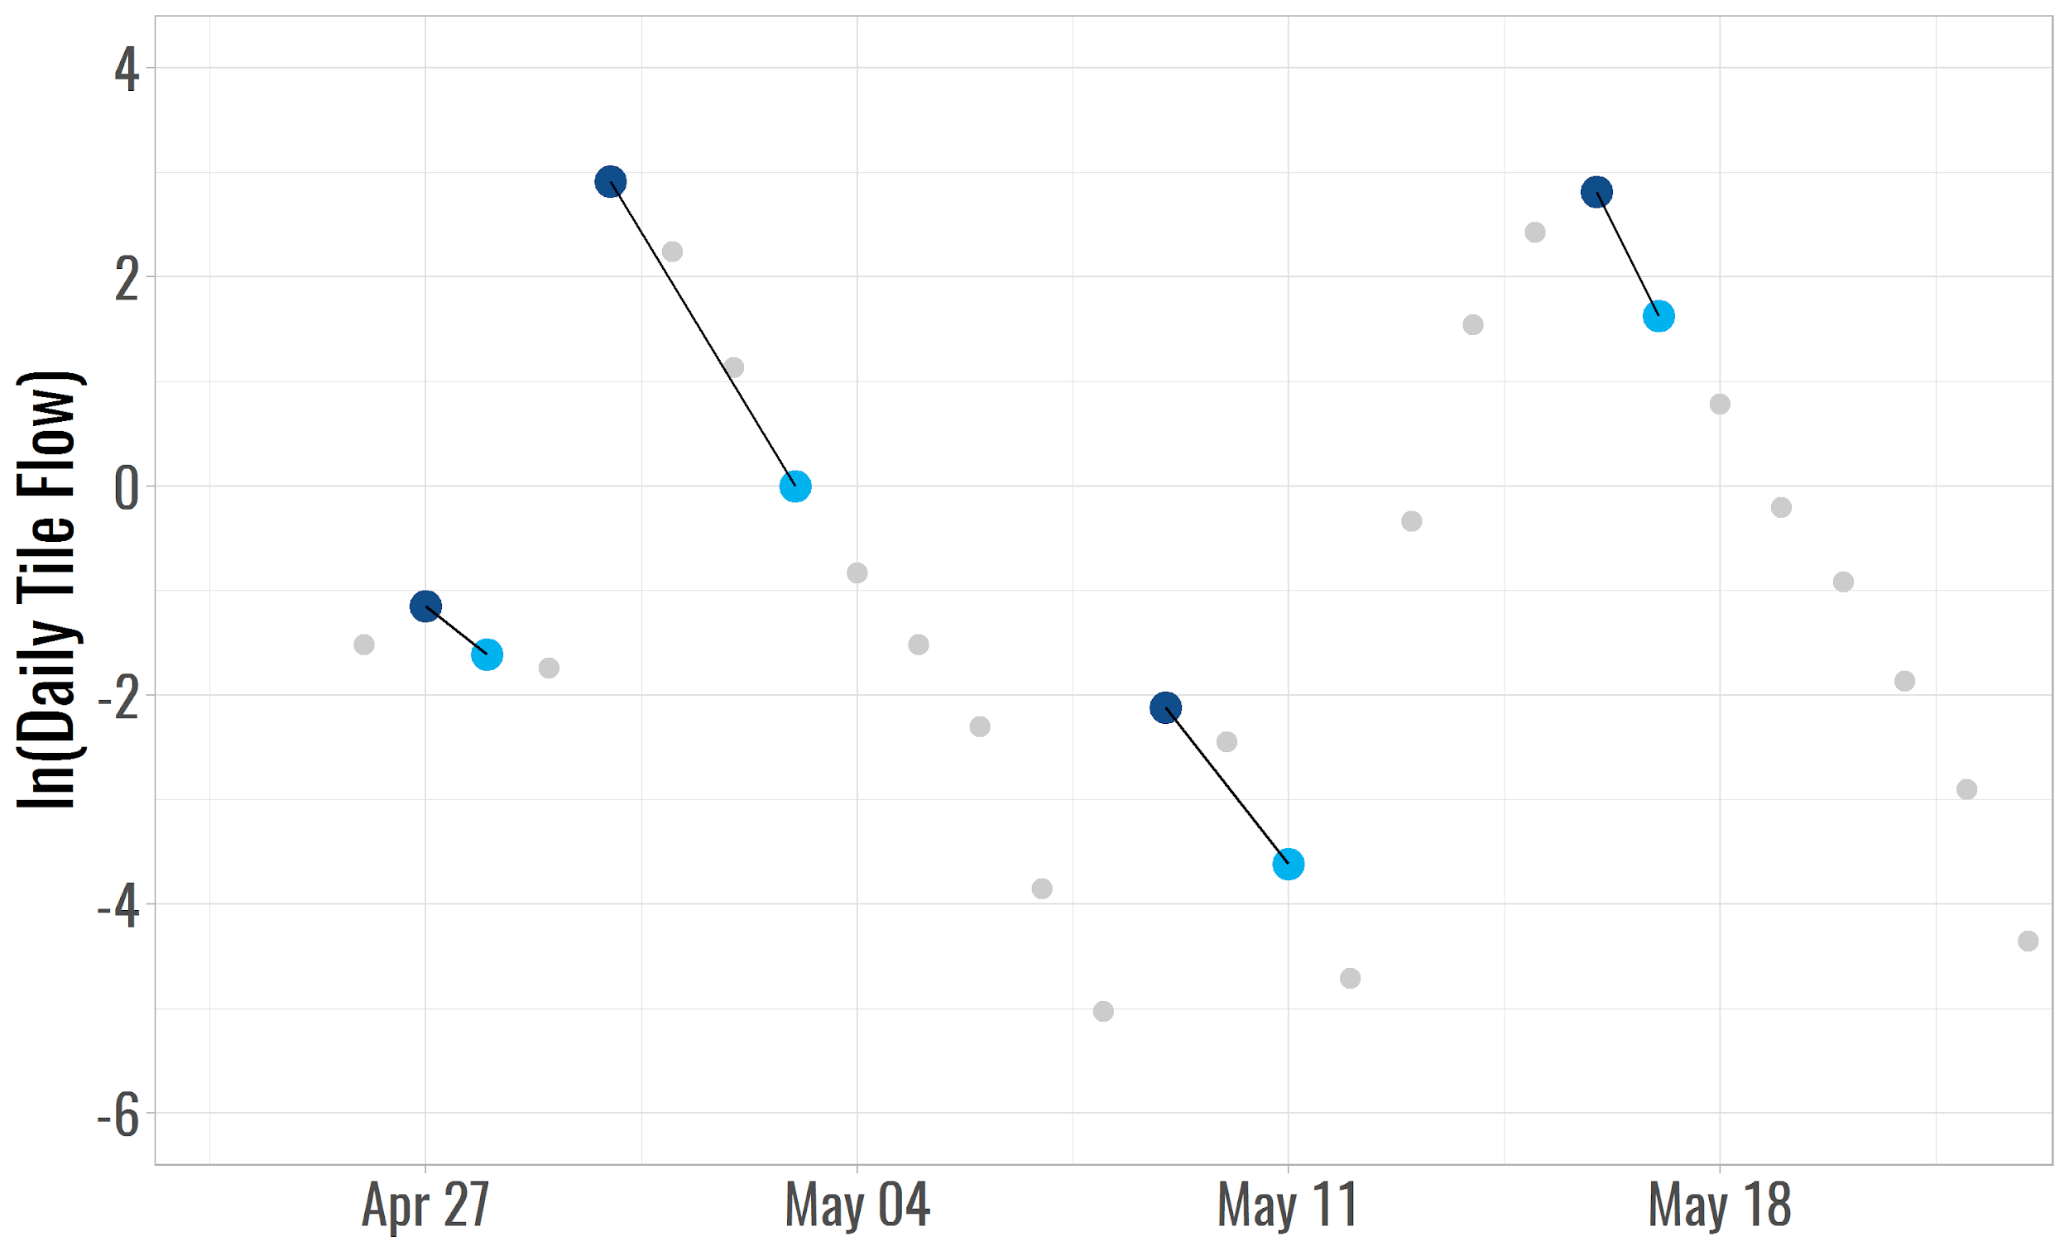
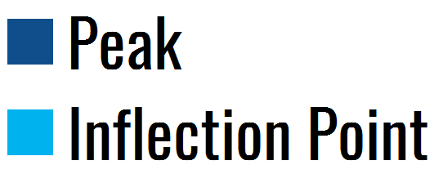
THE METHOD
Part 1 Predict Pick Flow
Part 2 Estimate Recession
Notes:
What should be the max gap for filling at STEP 2 and STEP 5
Snowmelt and thawing is NOT considered

Slide 12
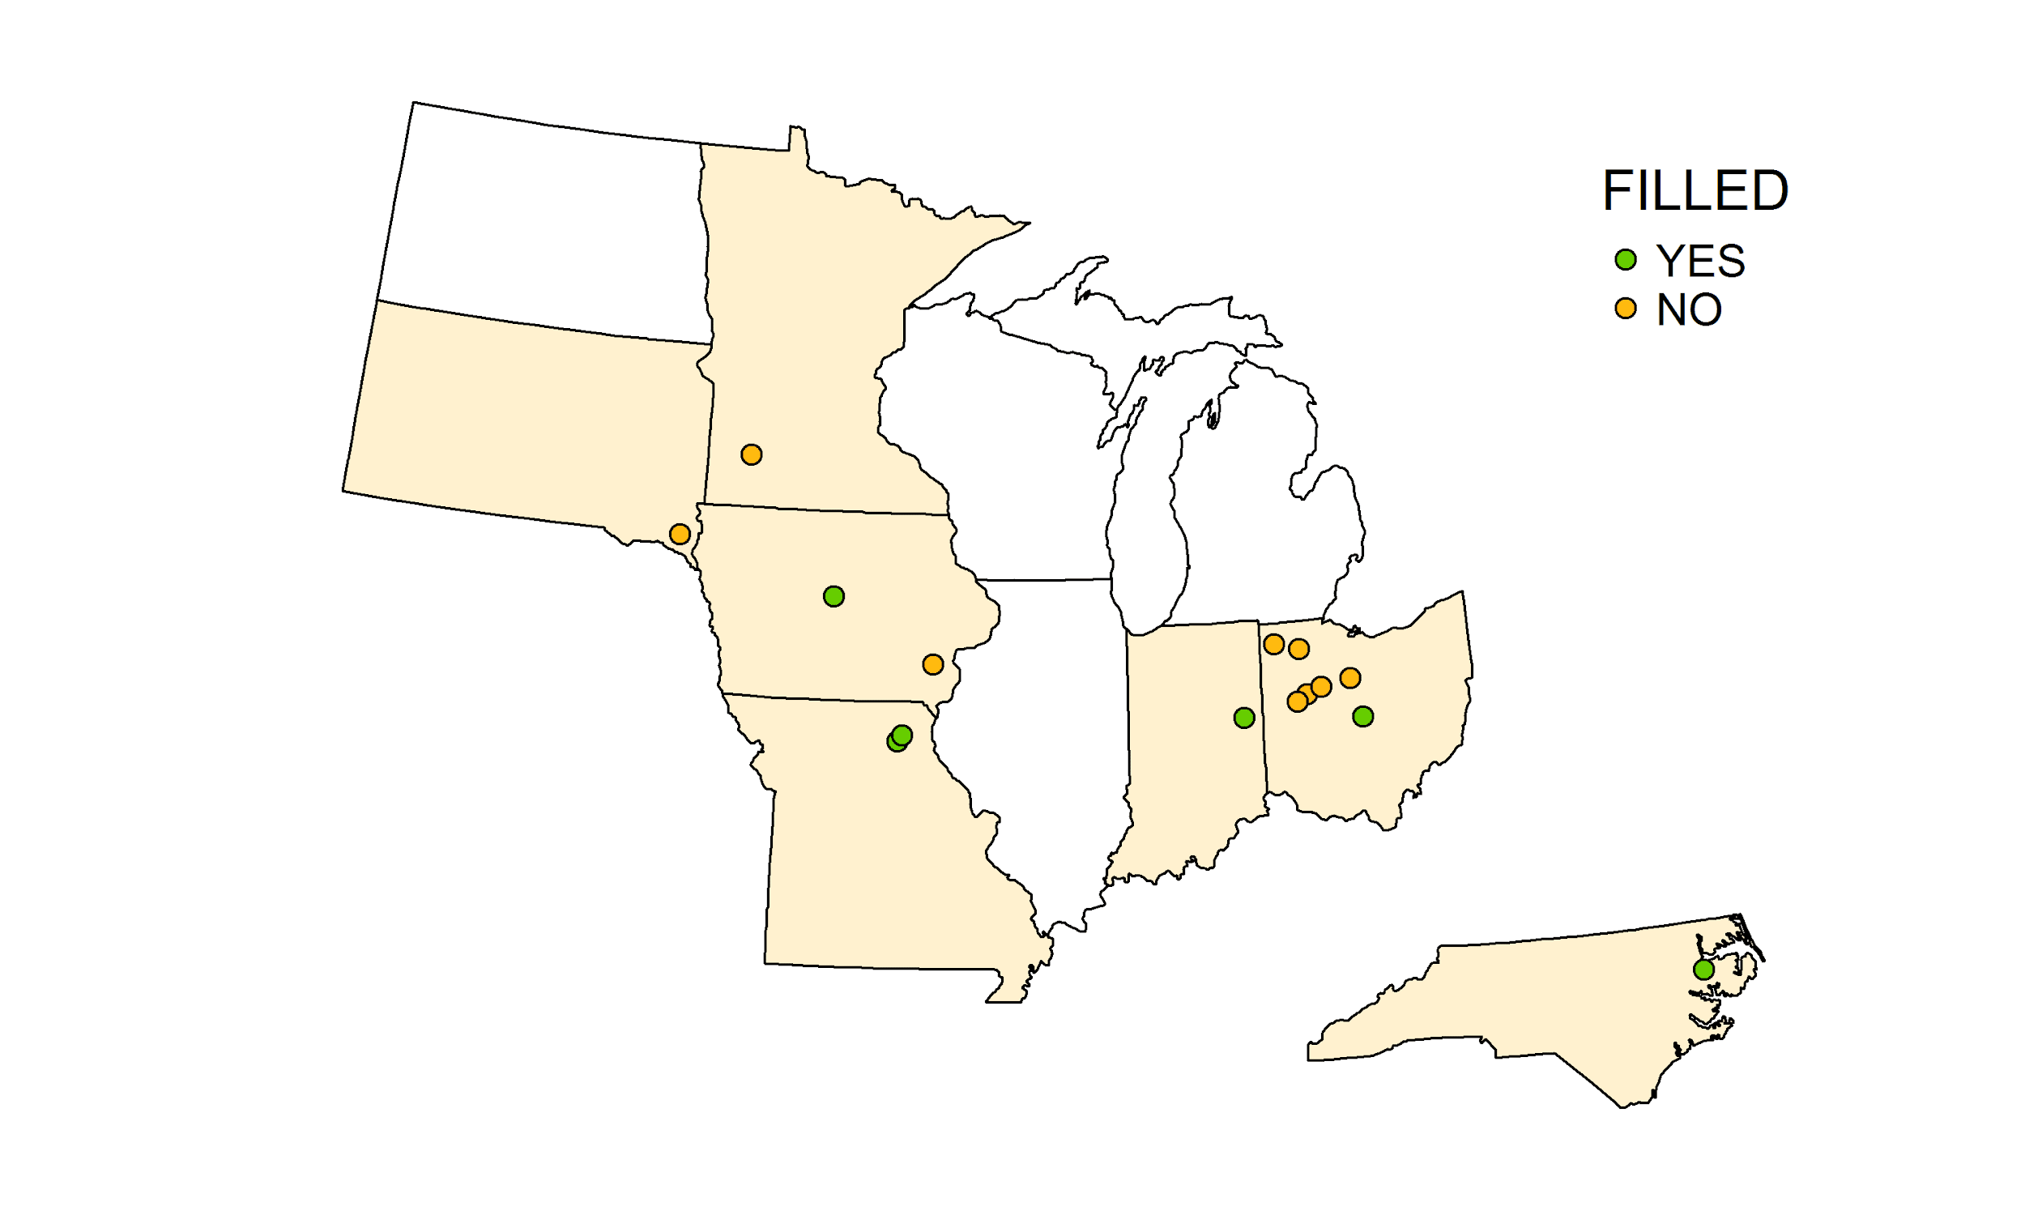
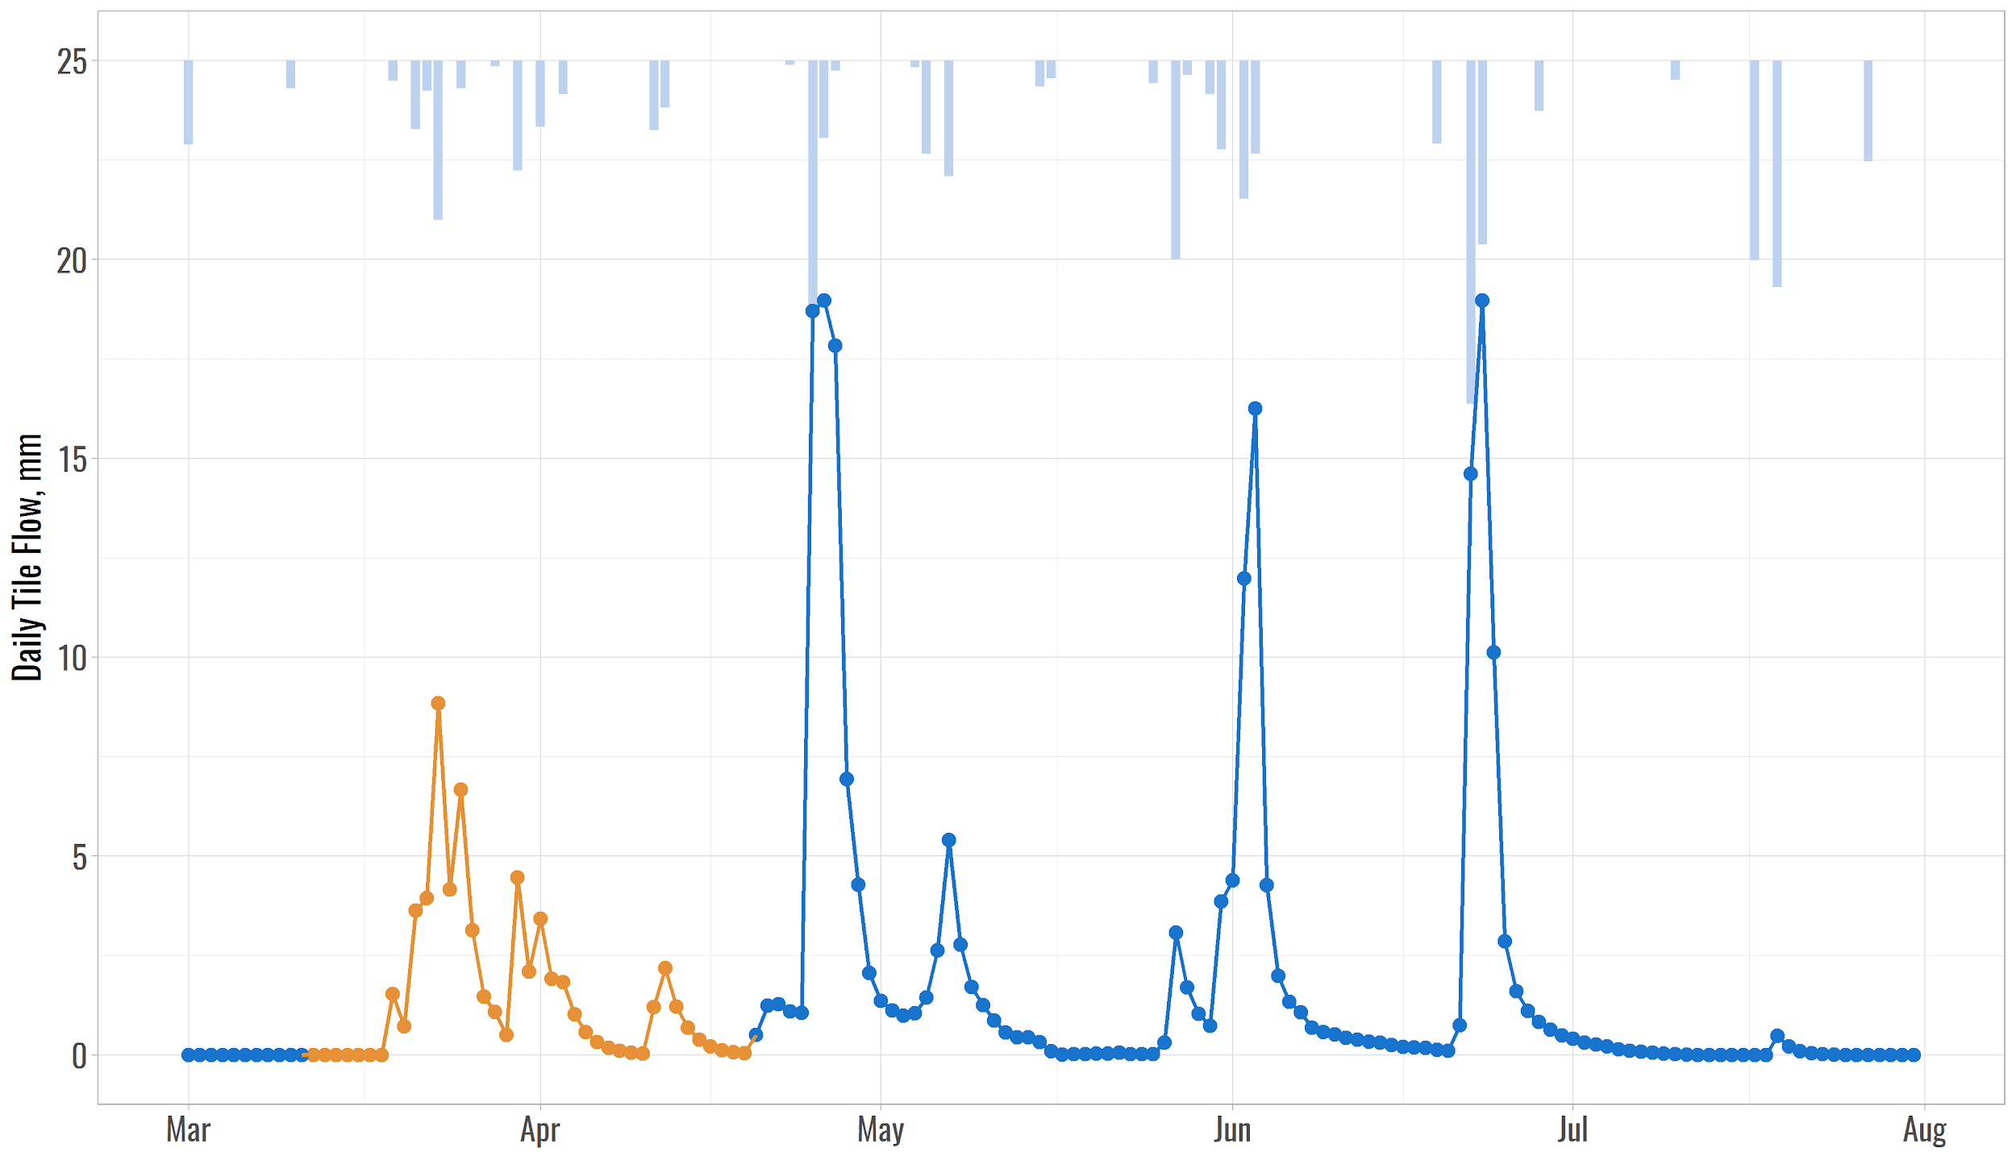
THE METHOD
Lack of on-site precipitation data
Method does not take into account board management
Snowmelt and thawing is not considered
Method needs more tweaking (parameters, assumptions, etc.)
Part 1 Predict Pick Flow
Part 2 Estimate Recession
Notes:
We estimate the Recession coefficient to calculating falling limb of flow after the Pick flow
What should be the max gap for filling at STEP 2 and STEP 5
Snowmelt and thawing is NOT considered

Slide 13
“Complete data are all alike
but every incomplete data is incomplete in its own way”

Slide 14
METHOD
Assumption
Drain flow occurs when precipitation is above a certain threshold on that day
This was 0 mm at DPAC
Drain flow continues if flow from the day before was above a certain threshold
This is estimated as an average daily flow during summer period
Snowmelt and thawing is not considered
Seasons
Winter = January (1), February (2), March (3)
Spring = April (4), May (5), June (6)
Summer = July (7), August (8), September (9)
Fall = October (10), November (11), December (12)
Regression
Estimate the minimum daily drain flow identifying a drainage event. This allows us to remove very small drainage events from the regression analysis.
Min. DF = average daily summer drain flow for the period of record
This was ~0.14 mm at DPAC
Calculate 3-day average precipitation for each day based on:
3-day avg. = sum(day, day-1, day-2)/3
Perform regression between daily measured drain flow and 3-day average precipitation for each season given the conditions:
Daily precipitation > 0 mm
Daily drain flow > Min. DF
Notes:
Needs to be tweaked
What is max gap for model to fill in? Can we use more than 4 hours
To eliminate subjectivity during the process

Slide 15
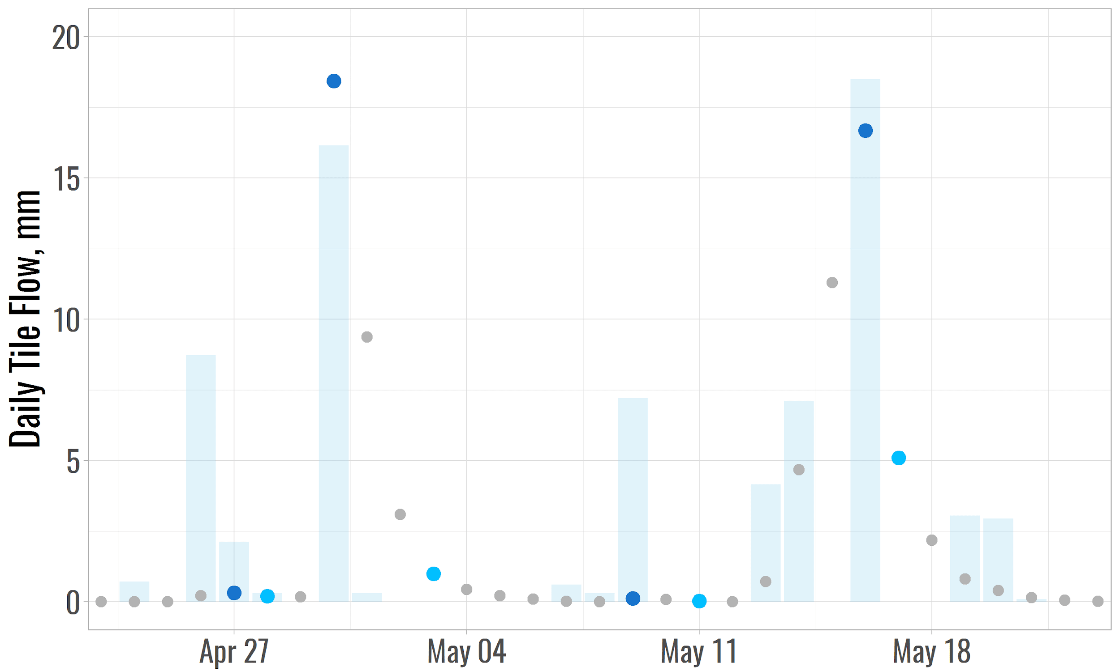
k
Qi = Qi-1 * e

Slide 16
